Slide 1
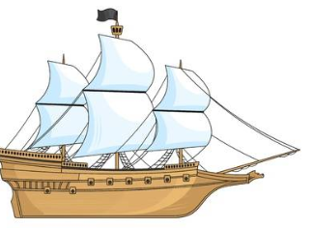
Computer Graphics
Team Project 1

Slide 2
Contents
Game Introduction
TCP / IP Socket Programming (PvP)
Water
- Reflection, Refraction
- DuDv map, Normal map
Terrain
- Height map
- Blend map
For system
Camera Movement
SkyBox
Collision Detection
GUI
Special Skills
Zoom blur
Particle
Zoom

Slide 3
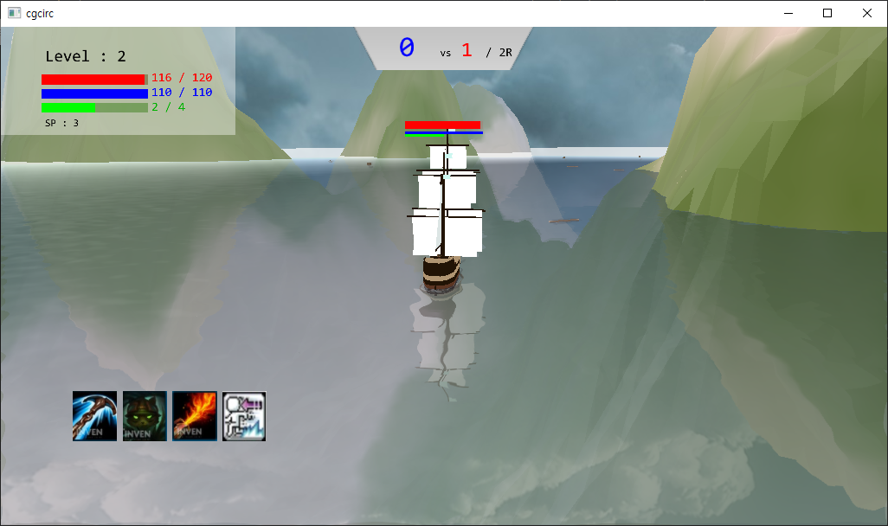
1. Battleship Game
Battleship Player vs Player game
Kill other player’s ship with canon attack, skills.
The aim is to achieve goal score.

Slide 4
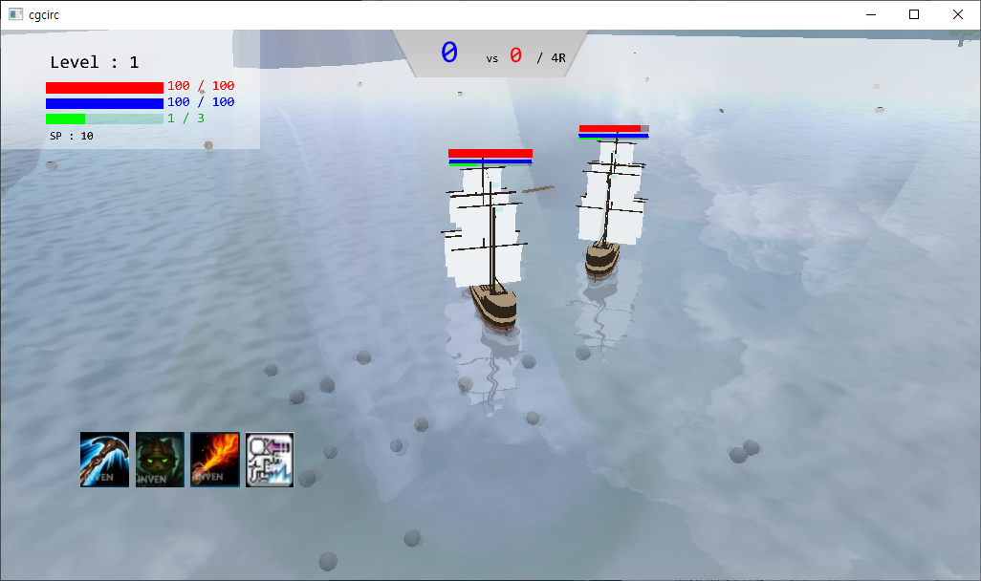
1. Battleship Game
Kill Score
My Status
Other ship status
Other ship
My Skills
My Ship
P2P way connection (TCP/IP)

Slide 5
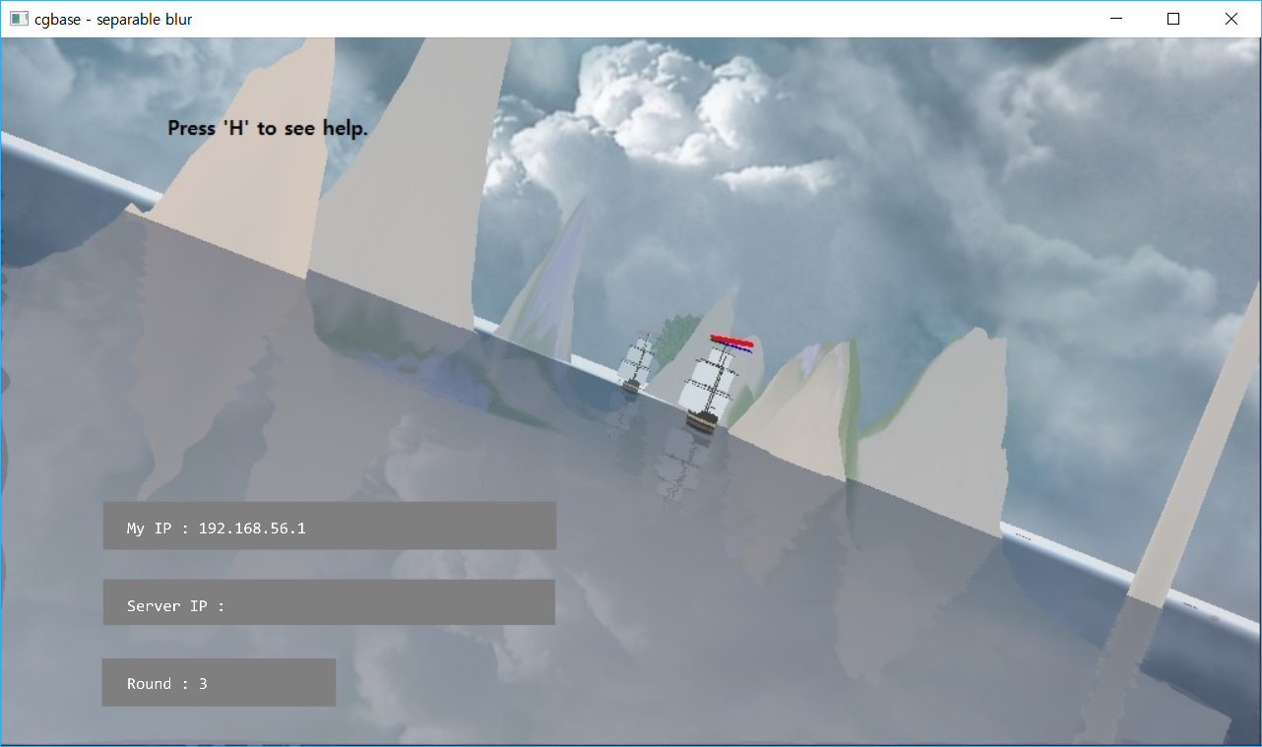
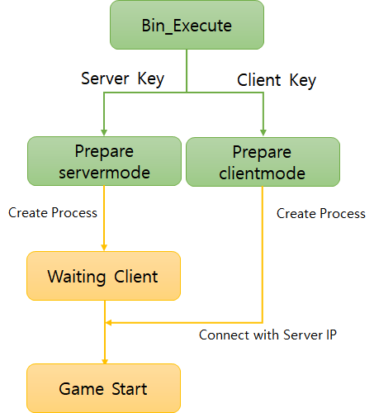
2. TCP IP Socket Programming
Press ‘+’ to do server role
write server player’s computer IP and press ‘Enter’
Then, bin_execute file will create process, main game.

Slide 6

2. TCP IP Socket Programming
Server
Client
Data Transfer
Ship position, angle, …
Ship position, angle, …
If the main game is executed, it will create a new thread to communicate each other.
All data transfer is performed at Update time.

Slide 7
2. TCP IP Socket Programming
HELPER
This is the first scene.
It will execute the main program along player setting.
It will pass the parameter to main (argc, argv)

Slide 8
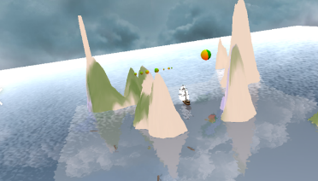
3. Water – Reflection, Refraction
The ocean is implemented by some frame buffers.
All objects are rendered 3 times.

Slide 9
3. Water – flow chart
Move Camera position (-z)
Step 1
Set the Clip space
Render all objects which are not clipped
Save to Reflection Frame buffer
Move Camera position correctly
Step 2
Set the Clip space
Render all objects which are not clipped
Save to Refraction Frame buffer
Disable the Clip space
Step 3
Render all object
Mix two frame buffer texture and render the water

Slide 10
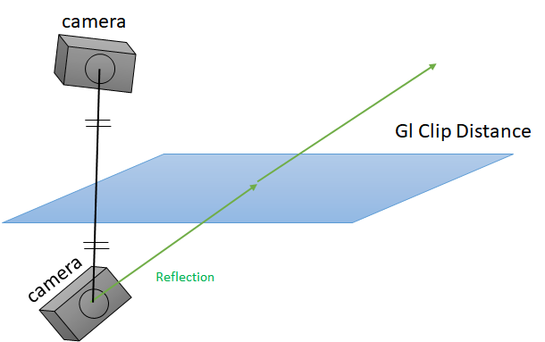
3. Water - reflection
For reflection, first we should move the camera position to under the water.
We should take a picture only above of water.
Therefore, gl Clip distance is used, and the clip plane is used in Vertex Shader.
It is a First Frame buffer Texture.

Slide 11
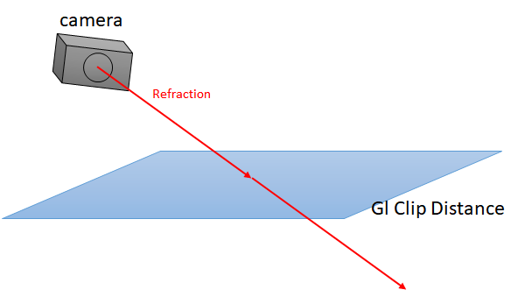
3. Water - refraction
For refraction, we don’t need to move the camera. (Snell’s law is not used)
We should take a picture only below of water.
It is same as reflection time, but the clip plane is inversed.
It is a Second Frame buffer Texture.

Slide 12
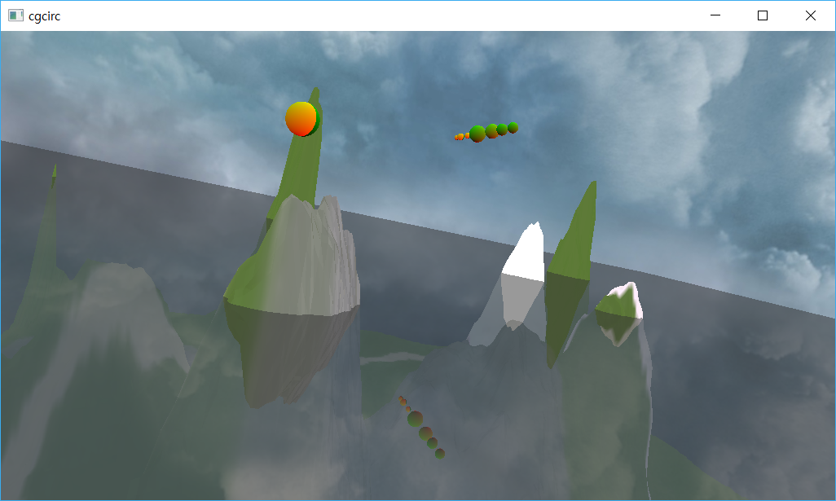
3. Water - mix
Third time, Render all objects.
To render water, Bind refraction texture, reflection texture, and mix it in Frag shader.

Slide 13
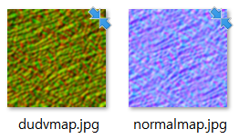
3. Water – dudv, normal map
For reality, we used dudv map and normal map.
Above jpg file is popular in internet.

Slide 14
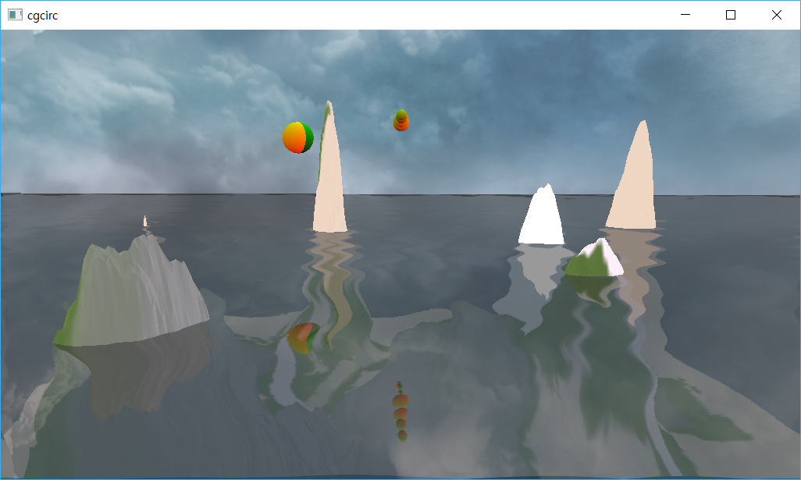
3. Water – dudv map
Dudv map makes distortion.
This texture will be used as texture coordinates and make water wave warp effect.
GL_REPEAT
To looks like flow, simple variable is transferred to vertex shader and change tc.

Slide 15
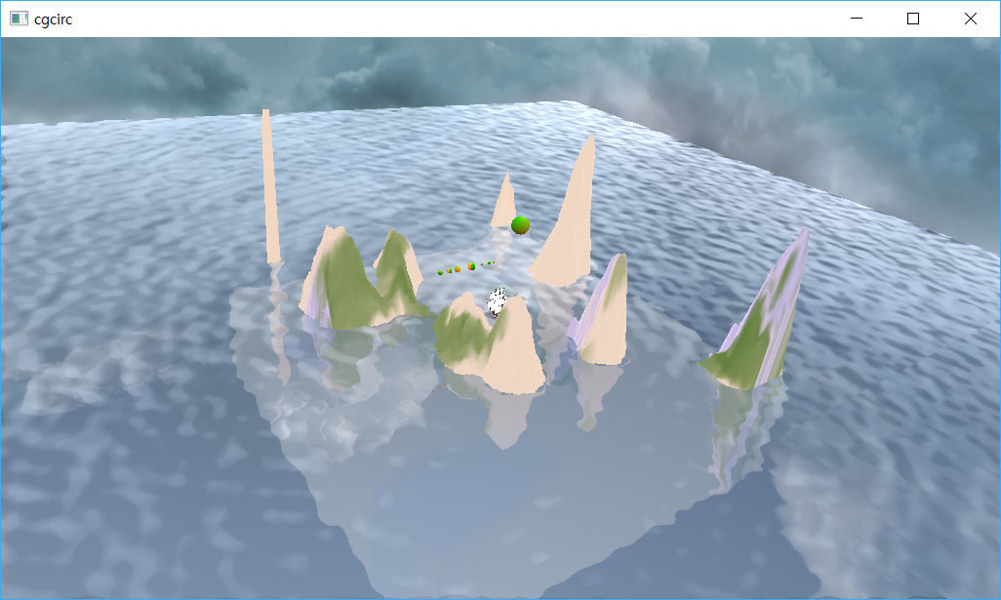
3. Water – normal map
Normal map is used to implement specular.
Light is calculated with normal vector.
Therefore, if we distort normal vector, then the specular light looks like above.

Slide 16
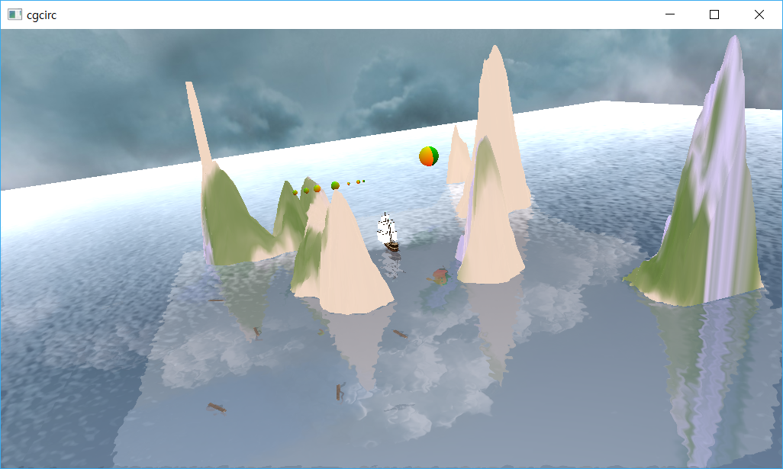
3. Water – Final Picture
Final Picture

Slide 17
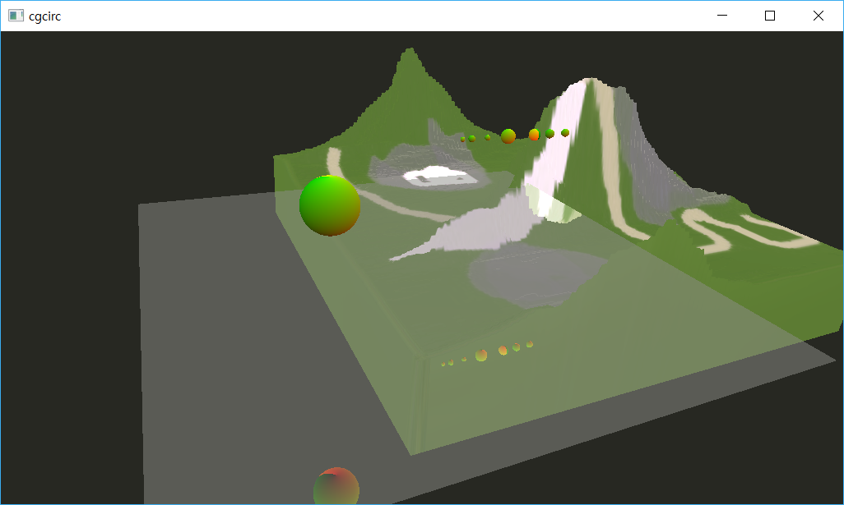
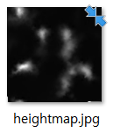
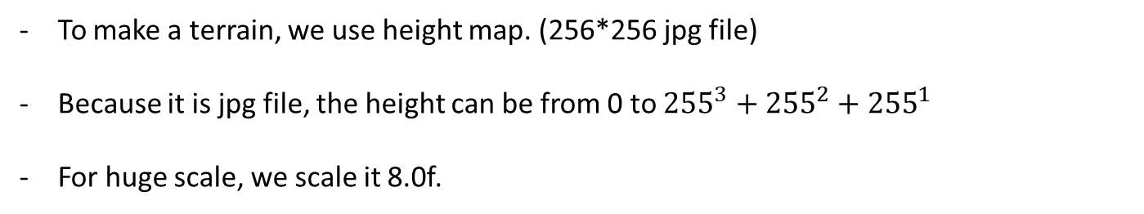
4. Terrain – Height map
To make a terrain, we use height map. (256*256 jpg file)
Because it is jpg file, the height can be from 0 to ${255}^{3}+{255}^{2}+{255}^{1}$
For huge scale, we scale it 8.0f.

Slide 18
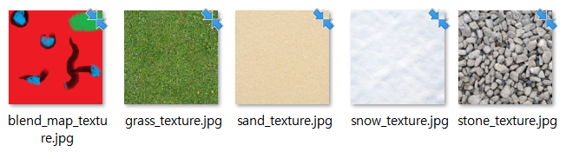
4. Terrain – Height map
Red value is sand texture
Green value is snow texture
Blue value is stone texture
1-(R+G+B) is grass texture

Slide 19
4. Terrain – Height map
All textures are bound by gl Activate Texture.
It is passed to fragment shader simultaneously.

Slide 20
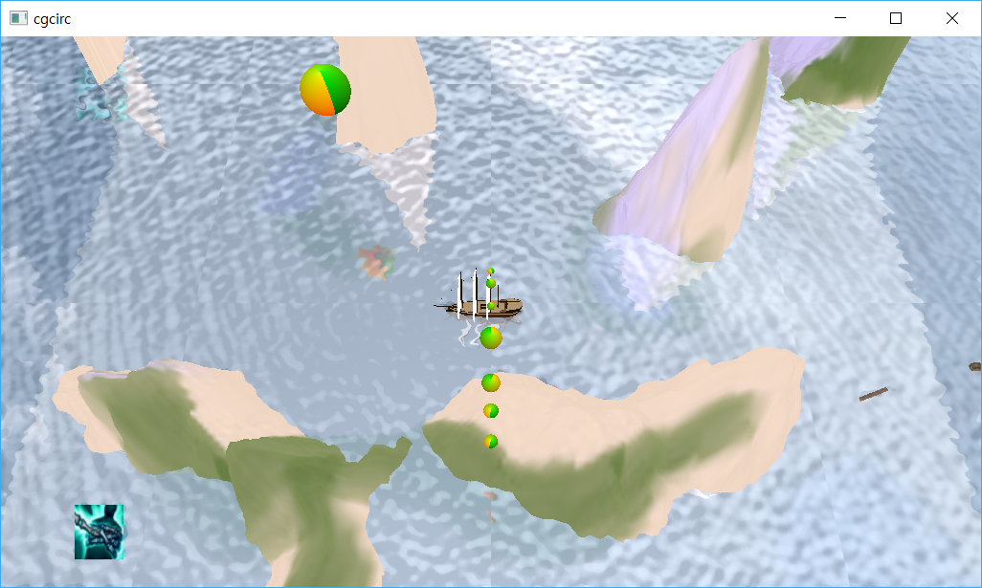
4. Terrain – Height map
We can get this terrain. Some texture is blended.

Slide 21
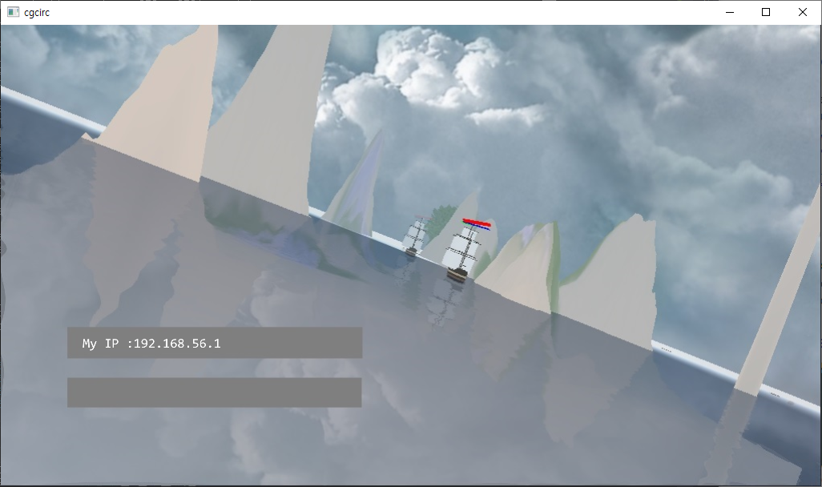
5. Fog System
Something objects which are located far, we can’t see it well.
For reality, we implement fog system.

Slide 22
5. Fog System
camera
If we pass the camera eye position to vertex shader, the glsl can know the distance.
Calculate the distance between gl_Position and camera eye.
Pass the distance to fragment shader.
Fragment shader will add sky color as much as value which use exponential function.

Slide 23
6. Camera Movement
camera
camera
camera
The camera position is controlled by mouse.
We can look same at position.
Camera move half above sphere, because under the water is ridiculous.
cam.eye = vec3(vec2(distance), 40.0f) - vec3(sin(angle - cur.x) * 80.0f, cos(angle - cur.x) * 80.0f, cur.y * 10.0f);

Slide 24
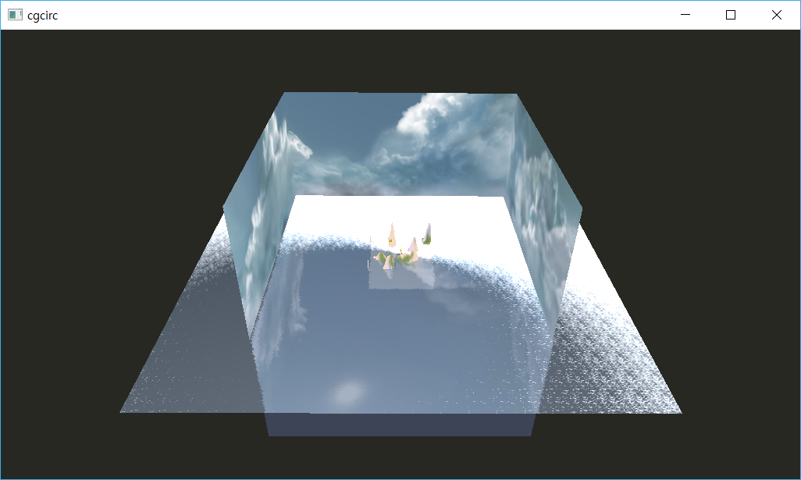
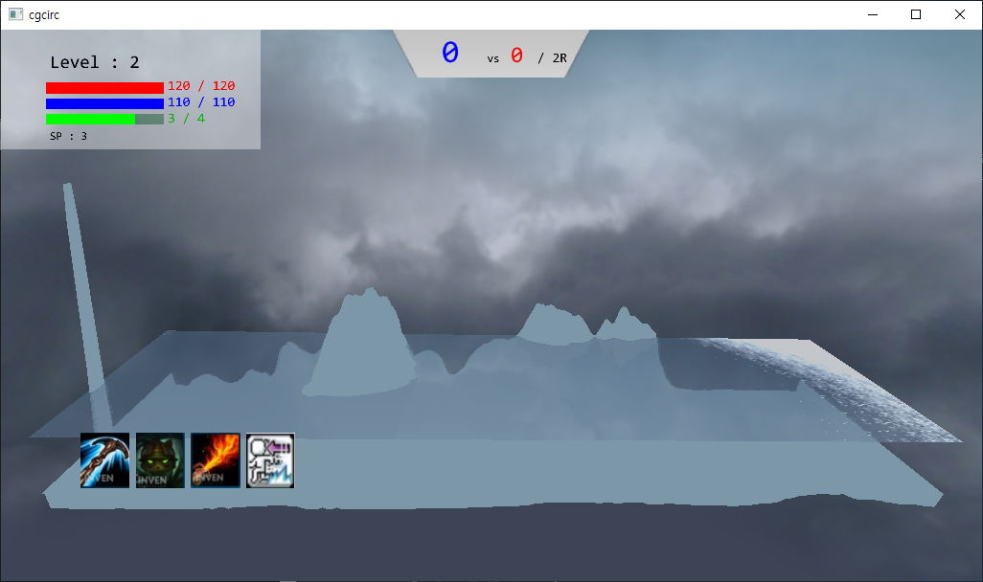
7. Sky box
The background is important things.
If we use just cube form, It looks like above.
To overcome this, we just get rid of the value of View matrix 3rows (eye)

Slide 25
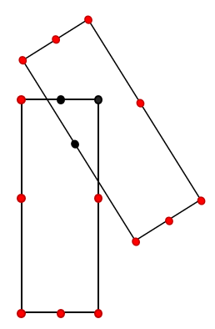
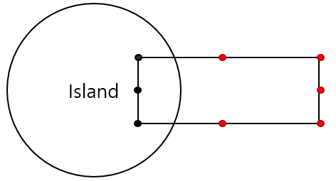
8. Collision Detection
For more elaborate, Between ship and ship, ship and terrain collision is detected by some points.
The number of points is 8, and these are every corner and every center of edge.

Slide 26
9. GUI
All GUIs are implemented by rectangle model and texture.
Above score board has a special shape. This is rendered by png file.

Slide 27




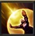




10. Special Skills
Server Skills
Client Skills
Anchor
Trap
Stealth
Barrier
Flamethrower
Sniper
Dash
Accelerator
Total 8 Skills, each has cool time, damage, duration etc..

Slide 28
10. Special Skills -Techniques
Server Skills
Client Skills
Nothing
Nothing
Alpha value control
Smooth GUI control
Particles
Zoom
Zoom blur

Slide 29
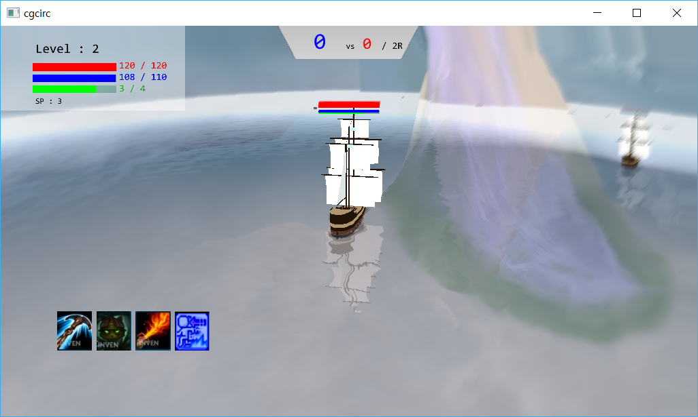
11. Zoom blur
Zoom blur
If player use dash skill or accelerator skill, the zoom blur effect is on.
To implement this, we use another frame buffer only if the blur is turned on.

Slide 30
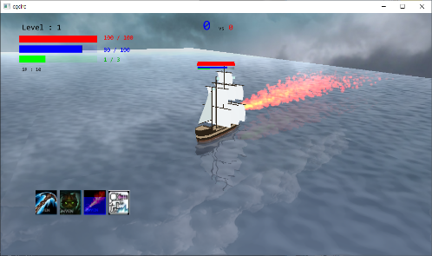
12. Particles
Particles
When player use flamethrower, particles will appear.
All particles position, color will be stored to array.
By glVertexAttribDivisor, texture vertex, position, color will be devided.
Position and Color is a unit of instance, the second parameter is 1
Used GL_ONE.

Slide 31
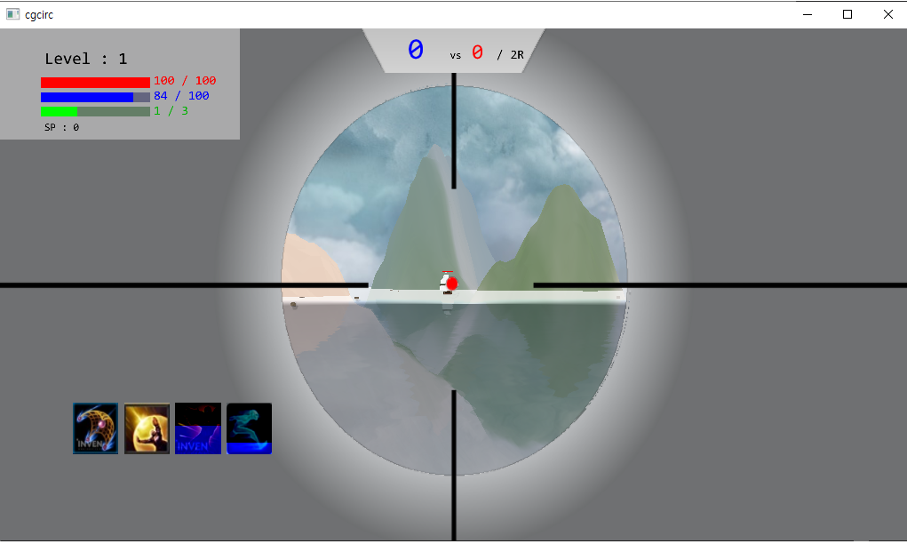
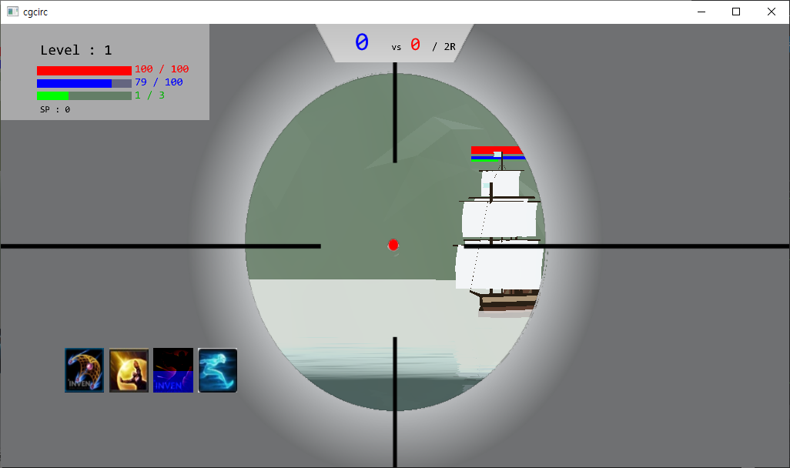
13. Zoom
Zoom
Above two pictures have same camera eye, at
It is controlled by modifying perspective matrix.

Slide 32
Thanks QnA

